Slide 1
Wrap-Up

Slide 2
Lesson Preview
Major topics revisited
Principles of KBAI revisited
Modern KBAI research
Final thoughts

Slide 3
Cognitive System
Metacognition
Deliberation
Reasoning
Input
Output
Learning
Memory
Reaction

Slide 4
The World
Input
Output
Cognitive System

Slide 5
The World
Cognitive System
Cognitive System
Cognitive System

Slide 6
Fundamentals
Planning
Common Sense Reasoning
Learning
Knowledge-Based Artificial Intelligence
Analogical Reasoning
Visuospatial Reasoning
Design & Creativity
Metacognition

Slide 7
Fundamentals
Semantic Networks
Generate and Test
Production Systems
Means-Ends Analysis
Problem Reduction

Slide 8
Planning
Logic
Planning

Slide 9
Common Sense Reasoning
Frames
Understanding
Common Sense Reasoning
Scripts

Slide 10
Learning
Learning by Recording Cases
Incremental Concept Learning
Classification
Version Spaces

Slide 11
Analogical Reasoning
Learning by Recording Cases
Case-Based Reasoning
Explanation-Based Learning
Analogical Reasoning

Slide 12
Visuospatial Reasoning
Constraint Propagation
Visuospatial Reasoning

Slide 13
Design & Creativity
Configuration
Diagnosis
Design
Creativity

Slide 14
Metacognition
Learning by Correcting Mistakes
Meta-Reasoning
Ethics in Artificial Intelligence

Slide 15
Principle #1: KBAI agents represent and organize knowledge into knowledge structures to guide and support reasoning.









⛵
⛵











⛵
⛵
⛵










⛵
⛵

Slide 16
Principle #1: KBAI agents represent and organize knowledge into knowledge structures to guide and support reasoning.
Sentence 1: A serious earthquake killed 25 people in Lower Slabovia.
Sentence 2: The President of Lower Slabovia killed 25 proposals for earthquake prediction.
kill. verb. /kil/
to cause the death of
to put an end to
kill1
agent :
victim :
kill2
agent :
object :

Slide 17
Principle #1: KBAI agents represent and organize knowledge into knowledge structures to guide and support reasoning.
S = Ashok; P = Olive Garden; W = Andrew
Action Frame
prim. : move-body-part
agent : Ashok
part : body
destination : sitting
Action Frame
prim. : move-object
agent : Andrew
object : Andrew
destination : Ashok
Action Frame
prim. : move-object
agent : Andrew
object : menu
destination : Ashok
Action Frame
prim. : see
agent : Andrew
object : Ashok

Slide 18
Principle #1: KBAI agents represent and organize knowledge into knowledge structures to guide and support reasoning.
Object
is
Cup
Object
is
Stable
Object
enables
Drinking
Object
has
Bottom
Bottom
is
Flat
Object
carries
Liquids
Object
is
Liftable
Object
made-of
Porcelain
Object
has
Concavity
Object
is
Light
Object
has
Decoration
Object
has
Handle

Slide 19
Principle #2: Learning in KBAI agents is often incremental.
Given new problem a
Retrieve most similar prior problem, b, from memory
Apply b’s solution to problem a
a
b
b
a

Slide 20
Principle #2: Learning in KBAI agents is often incremental.
Is the origin
North of 5_{N}?
Route | Destination_{X} | Destination_{Y}
A | 10_{E} | 8_{N}
B | 1_{E} | 8_{N}
C | 10_{E} | 4_{N}
D | 2_{E} | 1_{N}
X | 8_{E} | 2_{N}
Y | 8_{E} | 2_{N}
Z | 1_{E} | 9_{N}
Yes
No
East of 5_{E}?
East of 5_{E}?
Yes
No
Yes
No
C
East of 3_{E}?
D
B
Yes
No
X
East of 2_{E}?
Yes
No
A
Y

Slide 21
Principle #2: Learning in KBAI agents is often incremental.
Current Concept
An Arch
New Concept
Brick
Brick
Brick
supports
supports
supports
supports
supports
Brick
Brick
Brick
Brick
Brick
left-of
left-of
supports
supports
Brick
Brick
left-of

Slide 22
Principle #2: Learning in KBAI agents is often incremental.
Visit3
restaurant : Sam’s
meal : lunch
day : Saturday
cost : cheap
[any]
Breakfast
[any]
[any]
Sam’s
breakfast
Friday
cheap
Sam’s
[any]
[any]
cheap
Sam’s
[any]
[any]
[any]
[any]
[any]
[any]
[any]
[any]
[any]
[any]
cheap
Specific
General

Slide 23
Principle #2: Learning in KBAI agents is often incremental.
Object
is
Cup
Object
enables
Drinking
Object
is
Manipulable
Object
is
Orientable
Object
carries
Liquids
Object
is
Liftable
has
Object
is
Light
Object
Concavity
Handle
is
Fixed
has
Object
Handle

Slide 24
Principle #3: Reasoning in KBAI agents is top-down as well as bottom-up.
Angela ate lasagna with her dad last night at Olive Garden.
Ate
subject : Angela
object : lasagna
location : Olive Garden
time : night
utensils :
object-alive : false
object-is : in-subject
subject-mood : happy

Slide 25
Principle #3: Reasoning in KBAI agents is top-down as well as bottom-up.
Sentence 1: A serious earthquake killed 25 people in Lower Slabovia.
Sentence 2: The President of Lower Slabovia killed 25 proposals for earthquake prediction.
kill. verb. /kil/
to cause the death of
to put an end to
kill1
agent :
victim :
kill2
agent :
object :

Slide 26
Principle #3: Reasoning in KBAI agents is top-down as well as bottom-up.
S = Ashok; P = Olive Garden; W = Andrew
Action Frame
prim. : move-body-part
agent : Ashok
part : body
destination : sitting
Action Frame
prim. : move-object
agent : Andrew
object : Andrew
destination : Ashok
Action Frame
prim. : move-object
agent : Andrew
object : menu
destination : Ashok
Action Frame
prim. : see
agent : Andrew
object : Ashok

Slide 27
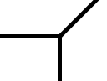



Principle #3: Reasoning in KBAI agents is top-down as well as bottom-up.
blade
Y-Constraint
W-Constraint
blade
fold
fold
fold
fold
fold
blade
blade
fold
blade
blade
L-Constraint
T-Constraint
fold
blade
blade
blade
blade
fold
blade
blade

Slide 28
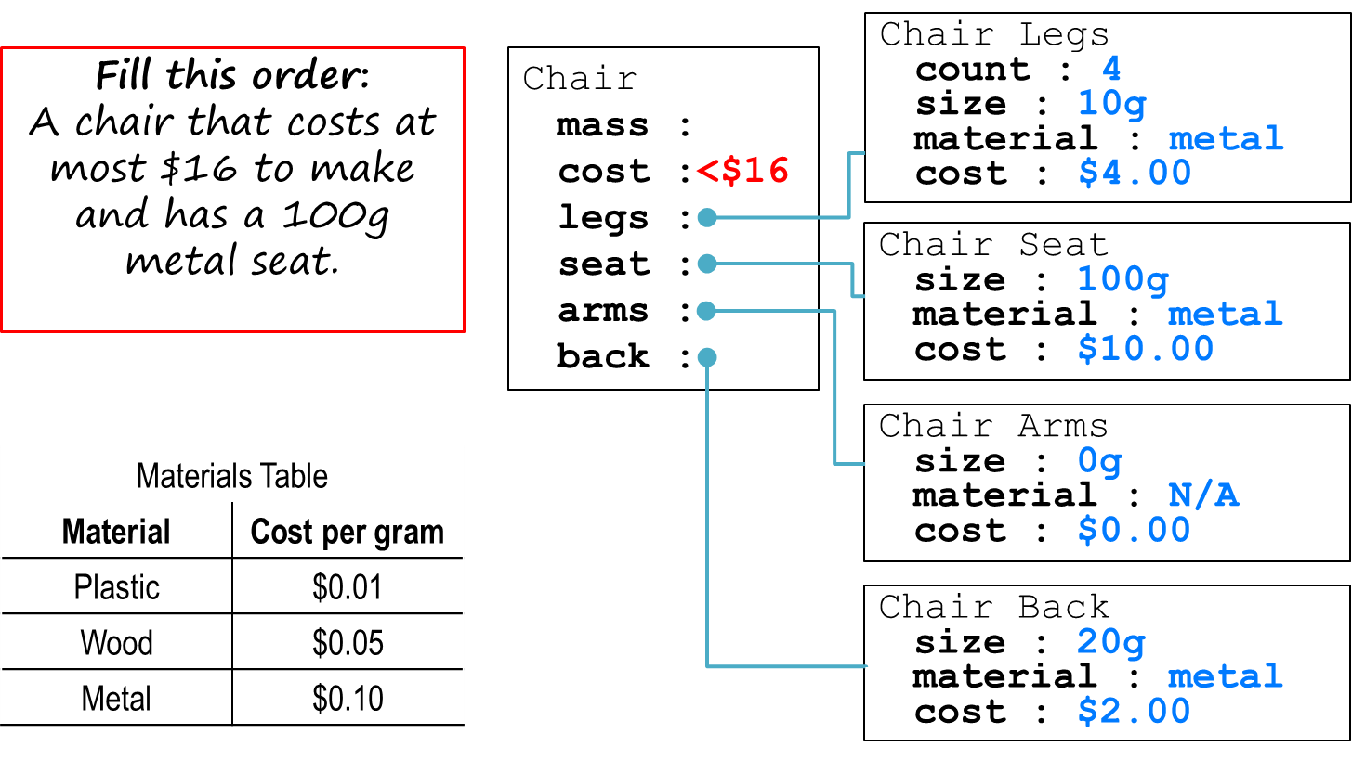
Principle #3: Reasoning in KBAI agents is top-down as well as bottom-up.
Notes:
Image credit:
https://commons.wikimedia.org/wiki/File:Chair_4a.jpg

Slide 29
Principle #4: KBAI agents match methods to tasks.
Methods
Generate & Test
Means-Ends Analysis
Problem Reduction
Production Systems
Case-Based Reasoning
Planning
Analogical Reasoning
Tasks
Configuration
Diagnosis
Design
Meta-Reasoning
Creativity
Classification
Systems Thinking

Slide 30
Principle #5: KBAI agents use heuristics to find solutions that are good enough, though not necessarily optimal.
Current Concept
Not an Arch
New Concept
Brick
Brick
Brick
must- support
must- support
supports
supports
Brick
Brick
Brick
Brick
Brick
Brick
left-of
left-of
left-of
“require-link” heuristic

Slide 31
Principle #5: KBAI agents use heuristics to find solutions that are good enough, though not necessarily optimal.
Initial State
A
B
C
Goal State
Δ = 2
A
C
C
B
A
B
A
B
C
A on Table
B on Table
C on A
Δ = 3
Δ = 3
A on B
B on C
C on Table
Δ = 0
B
C
A
Δ = 3

Slide 32
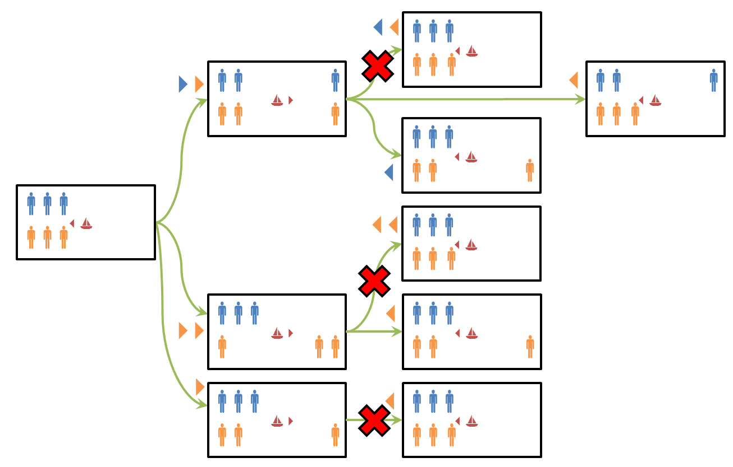
Principle #5: KBAI agents use heuristics to find solutions that are good enough, though not necessarily optimal.

Slide 33
Principle #6: KBAI agents make use of recurring patterns in the problems they solve.
What color is this block?
Block World
Red
Orange
?
Blue
Black
Green
Purple

Slide 34
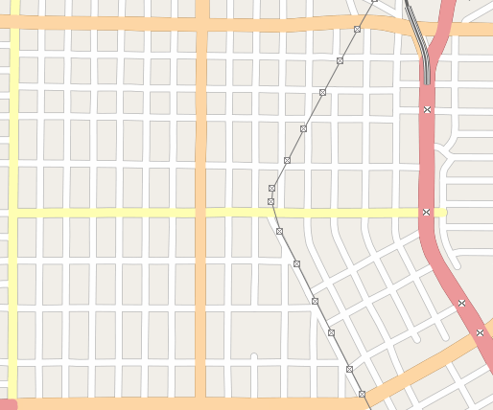
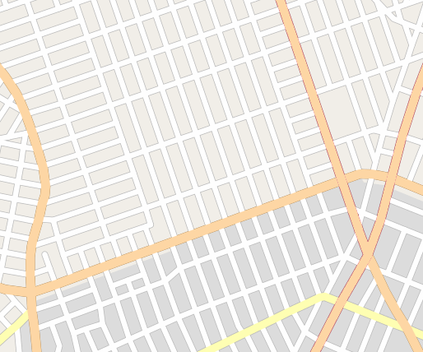
Principle #6: KBAI agents make use of recurring patterns in the problems they solve.

Slide 35
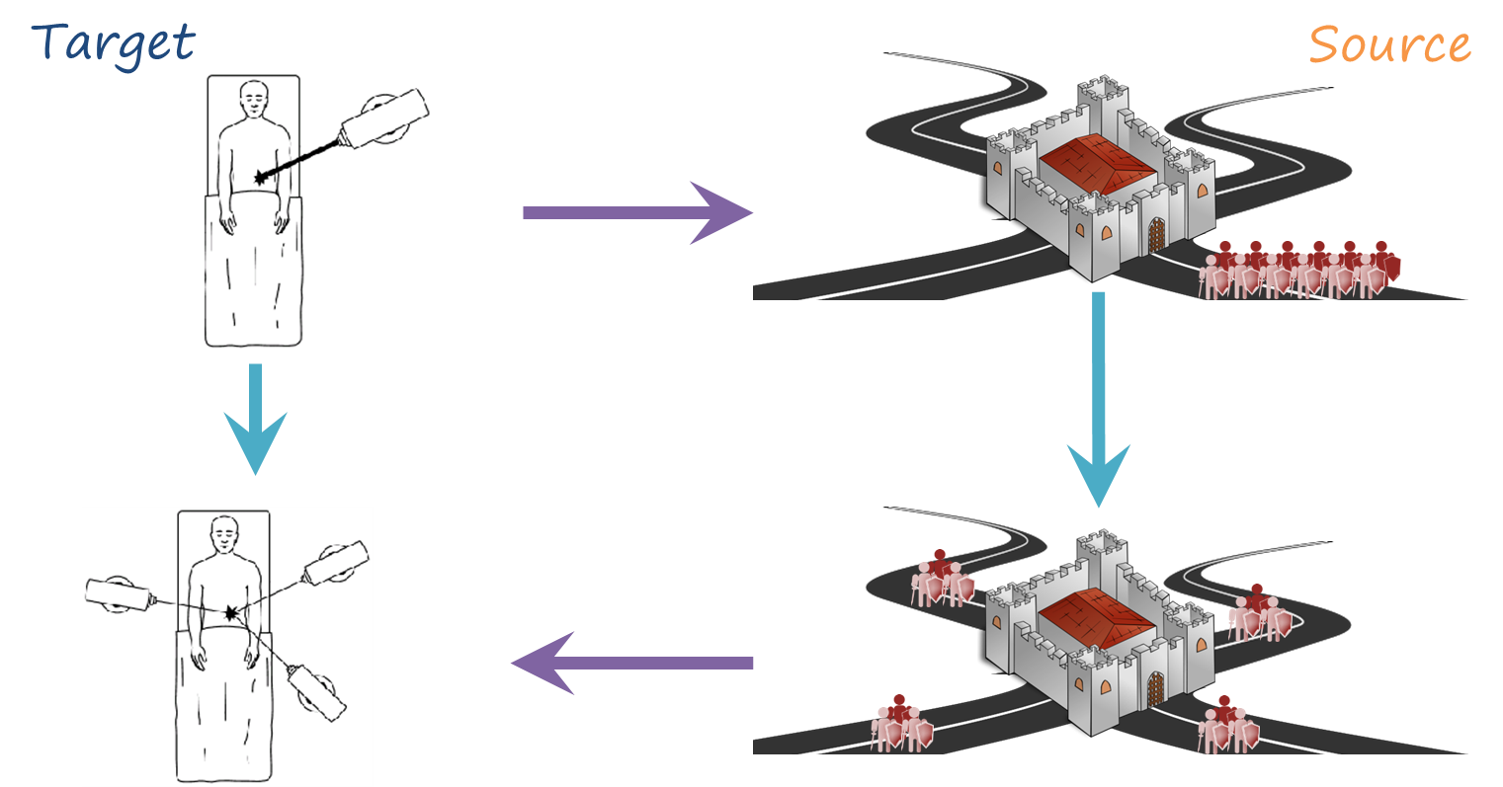
Principle #6: KBAI agents make use of recurring patterns in the problems they solve.

Slide 36
Principle #6: KBAI agents make use of recurring patterns in the problems they solve.
Notes:
Image credit:
https://commons.wikimedia.org/wiki/File:Chair_4a.jpg

Slide 37
Principle #6: KBAI agents make use of recurring patterns in the problems they solve.
S = Ashok; P = Olive Garden; W = Andrew
Action Frame
prim. : move-body-part
agent : Ashok
part : body
destination : sitting
Action Frame
prim. : move-object
agent : Andrew
object : Andrew
destination : Ashok
Action Frame
prim. : move-object
agent : Andrew
object : menu
destination : Ashok
Action Frame
prim. : see
agent : Andrew
object : Ashok

Slide 38
Principle #7: The architecture of KBAI agents enables reasoning, learning, and memory to support and constrain each other.
(r8) If two operators selected and one has an episode with result homerun
then prefer other operator
inning : 5th
portion : bottom
game : 131
weather : windy
runners : 1st, 3rd
outs : 1
batter : Pierzynski
average : .283
bats : left-handed
score : 1-4
goal : pitch
pitch : throw-fast-ball
result : homerun
“chunking”

Slide 39
Principle #7: The architecture of KBAI agents enables reasoning, learning, and memory to support and constrain each other.
If an animal flies and is not a bird, it is a bat.
Flies(animal)
∧
¬Bird(animal)
If Flies(animal) ∧ ¬Bird(animal):
Then Bat(Animal)

Slide 40
Principle #7: The architecture of KBAI agents enables reasoning, learning, and memory to support and constrain each other.
Object
is
Cup
Object
is
Stable
Object
enables
Drinking
Object
has
Bottom
Bottom
is
Flat
Object
carries
Liquids
Object
is
Liftable
Object
made-of
Porcelain
Object
has
Concavity
Object
is
Light
Object
has
Decoration
Object
has
Handle

Slide 41
Principle #7: The architecture of KBAI agents enables reasoning, learning, and memory to support and constrain each other.
Object
is
Cup
Object
enables
Drinking
Object
is
Manipulable
Object
is
Orientable
Object
carries
Liquids
Object
is
Liftable
Object
has
Concavity
Object
is
Light
Handle
is
Fixed
has
Object
Handle

Slide 42
CALO:
“Cognitive Assistant that Learns and Organizes”
Cyc and OMCS: Knowledgebases of everyday common sense knowledge
Wolfram Alpha:
A computational knowledge and answer engine.
VITA:
A computational model of visual thinking in autism, based on RPM.
Dramatis:
A computational model of suspense and drama in stories.
DANE:
Support for design based on analogies to natural systems.

Slide 43
What are some things Watson must be able to do to participate in Jeopardy? Write each on its own line below.
Read the clue
Search its knowledge base
Decide on an answer
Properly phrase that answer

Slide 44
Fundamental Conundrums of Artificial Intelligence
Intelligent agents have limited resources.
Computation is local, but problems have global constraints.
Logic is deductive, but many problems are not.
The world is dynamic, but knowledge is limited.
Problem solving, reasoning, and learning are complex, but explanation and justification are even more complex.

Slide 45
Characteristics of AI Problems
Knowledge often arrives incrementally.
Problems exhibit recurring patterns.
Problems have multiple levels of granularity.
Many problems are computationally intractable.
The world is dynamic, but knowledge of the world is static.
The world is open-ended, but knowledge is limited.

Slide 46
Characteristics of AI Agents
Agents have limited computing power.
Agents have limited sensors.
Agents have limited attention.
Computational logic is fundamentally deductive.
AI agents’ knowledge is incomplete relative to the world.

Slide 47
Deliberation
Reasoning
Learning
Memory

Slide 48
thinking
Agents that think rationally
Agents that think like humans
optimally
like humans
Agents that act rationally
Agents that act like humans
acting

Slide 49
thinking
machine learning
semantic web
optimally
like humans
airplane autopilot
improvisational robots
acting

Slide 50
thinking
1. Roomba (automated vacuum)
2. C-3PO (Star Wars)
3. Siri (Apple virtual assistant)
4. Google Maps (route navigation)
4
3
optimally
like humans
1
2
acting

Slide 51
What are cognitive systems?
Cognitive: dealing with human-like intelligence.
Systems: multiple interacting components such as learning, reasoning, and memory.
Cognitive Systems: Systems that exhibit human-like intelligence through processes like learning, reasoning, and memory.

Slide 52
The World
Input
Output
Cognitive System

Slide 53
The World
Cognitive System
Cognitive System
Cognitive System

Slide 54
Cognitive System
Metacognition
Deliberation
Reasoning
Input
Output
Learning
Memory
Reaction

Slide 55
Fundamentals
Planning
Common Sense Reasoning
Learning
Knowledge-Based Artificial Intelligence
Analogical Reasoning
Visuospatial Reasoning
Design & Creativity
Metacognition

Slide 56
Fundamentals
Semantic Networks
Generate and Test
Production Systems
Means-Ends Analysis
Problem Reduction

Slide 57
Planning
Logic
Planning

Slide 58
Common Sense Reasoning
Frames
Understanding
Common Sense Reasoning
Scripts

Slide 59
Learning
Learning by Recording Cases
Incremental Concept Learning
Classification
Version Spaces

Slide 60
Analogical Reasoning
Learning by Recording Cases
Case-Based Reasoning
Explanation-Based Learning
Analogical Reasoning

Slide 61
Visuospatial Reasoning
Constraint Propagation
Visuospatial Reasoning

Slide 62
Design & Creativity
Configuration
Diagnosis
Design
Creativity

Slide 63
Metacognition
Learning by Correcting Mistakes
Meta-Reasoning
Ethics in Artificial Intelligence

Slide 64
Semantic Networks
Frames
Logic
Generate and Test
Production Systems
Understanding
Planning
Common Sense Reasoning
Means-End Analysis
Problem Reduction
Scripts
Knowledge-Based Artificial Intelligence
Learning by Recording Cases
Learning by Recording Cases
Case-Based Reasoning
Incremental Concept Learning
Explanation-Based Reasoning
Classification
Scripts
Analogical Reasoning
Configuration
Learning by Correcting Mistakes
Constraint Propagation
Diagnosis
Meta-Reasoning
Design
Visuospatial Reasoning
Computational Creativity
Ethics in Artificial Intelligence

Slide 65
To recap…
Conundrums and characteristics
Four schools of AI
What is KBAI?
Cognitive Systems
Topics in AI

Slide 66
Introduction to CS7637

Slide 67
Lesson Preview
Class goals, outcomes, and strategies
Class projects and assessments
Computational psychometrics
Raven’s Progressive Matrices
Principles of CS7637

Slide 68
You will learn…
Core methods of knowledge-based AI
Tasks addressed by knowledge-based AI
How knowledge-based AI agents use these methods to address these tasks
The relationship between AI and human cognition

Slide 69
You will be able to…
Design and implement a knowledge-based AI agent
Use these strategies and agents to address complex, practical problems
Use the design and results of these agents to reflect on human cognition

Slide 70
You will learn by…
Learning by Example
Learning by Doing
Project-Based Learning
Personalization
Learning by Reflection

Slide 71
You will complete…
Projects
Short assignments
Tests
Exercises
Discussions

Slide 72
Raven’s Progressive Matrices
Test written in the 1930s to examine general intelligence.
Consists of 60 multiple-choice visual analogy problems.
Unique in that problems are strictly visual.
Widespread usage as a valid test for intelligence.

Slide 73
Problems
2x1 matrix problems
2x2 matrix problems
3x3 matrix problems

Slide 74
A
B
C
#
?
1
2
3
4
5
6
ο
ο
ο
ο
ο
ο

Slide 75
A
B
C
#
?
1
2
3
4
5
6
ο
ο
ο
ο
ο
ο

Slide 76
A
B
C
#
?
1
2
3
4
5
6
ο
ο
ο
ο
ο
ο

Slide 77
A
B
C
#
?
1
2
3
4
5
6
ο
ο
ο
ο
ο
ο

Slide 78
1
4
ο
ο
A
B
2
5
ο
ο
C
#
?
3
6
ο
ο

Slide 79
1
4
ο
ο
A
B
2
5
ο
ο
C
#
?
3
6
ο
ο

Slide 80
1
4
ο
ο
A
B
2
5
ο
ο
C
#
?
3
6
ο
ο

Slide 81
A
B
C
1
4
ο
ο
B
D
E
F
2
5
ο
ο
G
H
#
?
3
6
ο
ο

Slide 82
A
B
C
1
4
ο
ο
D
E
F
2
5
ο
ο
G
H
#
?
3
6
ο
ο

Slide 83
Principles of CS7637
1. KBAI agents represent and organize knowledge into knowledge structures to guide and support reasoning.
2. Learning in KBAI agents is often incremental.
3. Reasoning in KBAI agents is top-down as well as bottom-up.
4. KBAI agents match methods to tasks.
5. KBAI agents use heuristics to find solutions that are good enough, though not necessarily optimal.
6. KBAI agents make use of recurring patterns in the problems they solve.
7. The architecture of KBAI agents enables reasoning, learning, and memory to support and constrain each other.

Slide 84
Frequently-used readings
Artificial Intelligence by Patrick Winston
Knowledge Systems by Mark Stefik
Artificial Intelligence by Elaine Rich and Kevin Knight
Artificial Intelligence: A Modern Approach by Stuart Russell and Peter Norvig

Slide 85
To recap…
Class goals, outcomes, and strategies
The Project: Raven’s Progressive Matrices
Principles of CS7637

